Slide 1
Battle of Neighborhoods – Final Report
Coursera Capstone Project

Slide 2
Introduction

Slide 3
Scenario and background of the business problem
In this project we will compare neigborhoods of Toronto, CA and Manhattan NY, USA to see similarities in them in terms of accessibility to public transportation, restaurants, cafes and popular venues of entertainment.

Slide 4
Problem at hand
I am currently working in logistics and one of my clients who is based in Yonge Street, Toronto is considering shifting her base to Manhattan NY. Yonge Street is one of the busiest streets in Toronto and at one time was the longest streets in the world. It has vibrant shopping centres, restaurants, array of cafes, theatre halls and is also a corridoor to the beautiful Lake Ontario. Manhattan is a densely populated borough of NYC.
My client prefers to stay in a rented appartment for initial few months and has a limited budget. She would like to reside in a locality that offers similar characteristics and benefits to that of Yonge Street, Toronto. The appartment should contain atleast 2 bedrooms with monthly rent less than US$7000/month. The unit should be located within walking distance (<=1.0 mile, 1.6 km) from a subway metro station in Manhattan NY.
The analysis will be useful in finding her a place in Manhattan NY similar to her current location in Toronto, keeping in mind her requirements. The use of FourSquare and mapping techniques combined with data analysis will help resolve the key questions at hand.

Slide 5
Data Description

Slide 6
First we shall use Foursquare to identify the venues around the area of Yonge Street. It will serve as a reference for comparison with the desired future location in Manhattan NY. In order to make a good choice of a similar apartment in Manhattan NY, we need data of
List/Information on neighborhoods form Manhattan with their Geodata ( latitude and longitude).
List/Information about the subway metro stations in Manhattan with geodata.
Listed apartments for rent in Manhattan area with descriptions ( how many beds, price, location, address) Venues and ammenities in the Manhattan neighborhoods (e.g. top 10)
Sources and manipulation of the list of Manhattan neighborhoods is worked out during LAb exercise during the course. A csv file was created which will be read in order to create a dataframe and its mapping. A list of Manhattan subway metro stops was complied in Numbers (Apple excel) and it was complemeted with wikipedia data ( https://en.wikipedia.org/wiki/List_of_New_York_City_Subway_stations_in_Manhattan) and information from NY Transit authority and Google maps (https://www.google.com/maps/search/manhattan+subway+metro+stations/@40.7837297,-74.1033043,11z/data=!3m1!4b1) for a final consolidated list of subway stops names and their address. The geolocation was obtained via an algorythm using Nominatim

Slide 7
A list of places for rent was collected by web-browsing real estate companies in Manhattan : http://www.rentmanhattan.com/index.cfm?page=search&state=results https://www.nestpick.com/search?city=new-york&page=1&order=relevance&district=manhattan&gclid=CjwKCAiAjNjgBRAgEiwAGLlf2hkP3A-cPxjZYkURqQEswQK2jKQEpv_MvKcrIhRWRzNkc_r-fGi0lxoCA7cQAvD_BwE&type=apartment&display=listhttps://www.realtor.com/apartments/Manhattan_NY A csv file was compiled with the rental place that indicated: areas of Manhattan, address, number of beds, area and monthly rental price.Foursquare is used to find the avenues at Manhattan neighborhoods in general and a cluster is created to later be able to search for the venues depending of the location shown.
Foursquare and geopy data will be used to map top 10 venues for all Manhattan neighborhoods and clustered in groups (as per Course LAB). Foursquare and geopy data will be used to map the location of subway metro stations, separately and on top of the above a clustered map will be generated to identify the venues and amenities near each metro station. Foursquare and geopy data will be used to map the location of rental places, in some form, linked to the subway locations. A map would be created that depicts, the average rental price per square ft, around a radius of 1.0 mile (1.6 km) around each subway station - or a similar metrics.

Slide 8
Methodology

Slide 9
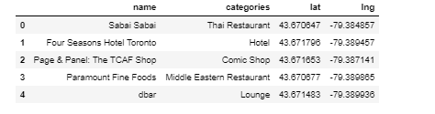
First the Toronto Yonge Street Neighborhood and Nearby Venues were inspected. Foursquare was dialed to find venues around current residence in Toronto. The data frame looks like this:

Slide 10
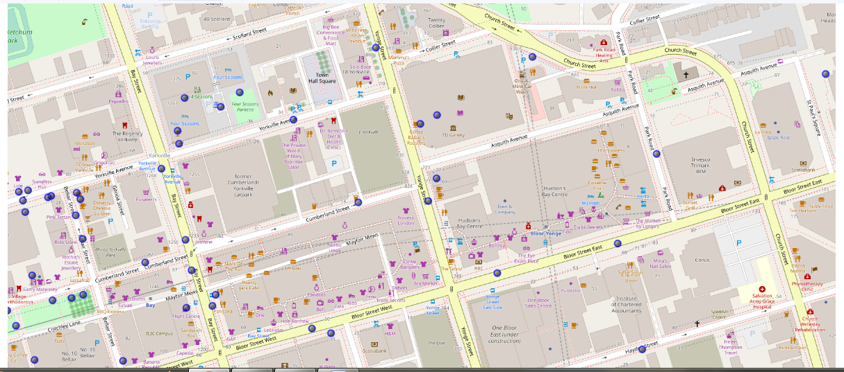
And this is how the map of Yonge Street looks like with its nearby places.

Slide 11
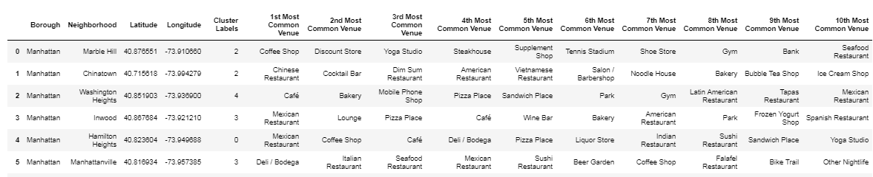
Then we explored the neighbourhoods of Manhattan NY. The data frame looks like this.
After examining cluster data, it is observed that cluster # 3 resembles Yonge Street neighborhood, therefore providing guidance as to where to look for the future apartment.

Slide 12
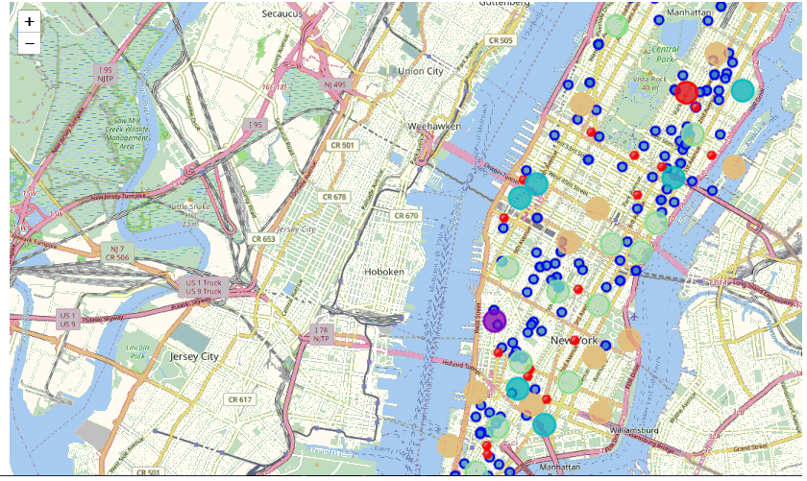
Data of apartment rents and nearby subways in Manhattan NY were analysed. A Consolidated Map showing apartments for rent, nearby subway locations and having nearby venues like that in a cluster was drawn up.

Slide 13
Discussion, Recommendation and Conclusion

Slide 14
Thanks to the Consolidated map generated it is convenient to locate clusters of our choice and the apartments for rent in these clusters along with nearby subway locations. Our choice of Cluster as discussed in the previous section was Cluster 3 since it resembles the Yonge Street neigborhood nearby locations. I was able to select an apartment:
Apartment 210 East 68th Street in Lennox Hill Cluster (3), monthly rent of $6900, close to 72 Street Subway station
I will surely recommend this apartment to my client. Since the rent is within her budget and the location is very similar to her present location in Yonge Street it is a very desirable location for her in Manhattan NY!

Slide 15
Thank you

